Slide 1
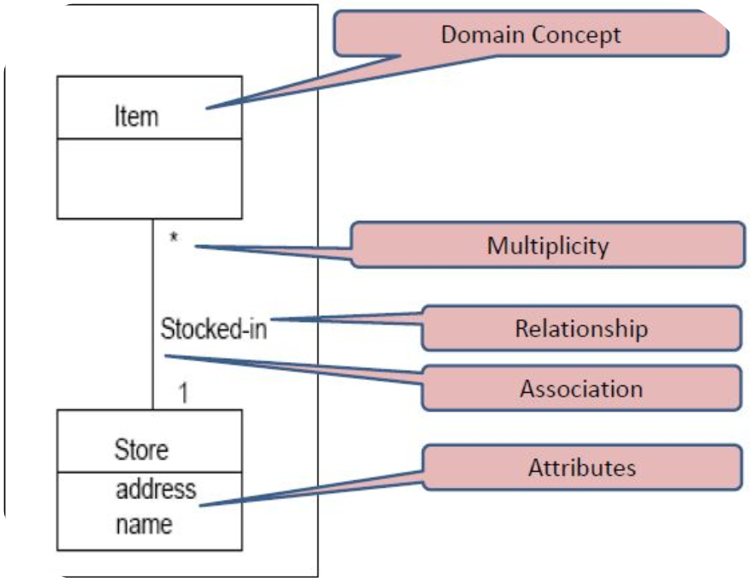
DOMAIN MODEL

Slide 2
DOMAIN MODEL:
A domain model is a visual representation of conceptual classes or real world objects in a domain of interest.
In iterative development, Domain model is incrementally build in several iterations of elaboration
In a domain model we identify
  Conceptual classes
  Associations
  Attributes

Slide 3
CONCEPTUAL CLASS:
Domain model illustrates conceptual classes or vocabulary in the domain
It is an idea, thing, or object.
A conceptual class may be considered as a symbol, intension, and extension
  Symbol: words or images representing a conceptual class
  Intension: the definition of a conceptual class
  Extension: the set of examples to which the conceptual class applies

Slide 4
CONCEPTUAL CLASS IDENTIFICATION:
Widely used techniques are
  Use a conceptual class category list
  Identify noun phrase from use cases text, scenario
It is better to over specify a domain model

Slide 5
NOUNS AND NOUN PHRASES:
A customer arrives at the checkout with a basket of goods. The cashier scans each product. The price of each item is determined by the system, and the price of each transaction is displayed to the customer and recorded on the receipt. The total is shown to the customer, who makes a payment, perhaps using a credit card.
Use a small number of related Use Cases
Identify all the nouns and noun phrases
  Highlight, Underline, Copy to whiteboard
At this stage, don’t do any other processing
  Removal of duplicates, looking for synonyms, identifying hierarchy
Provides a good list of candidate classes
Notes:
Nouns are the ‘things’ under investigation. Noun phrases provide more description. Normally, a small number of closely-related Use Cases would be analysed, providing a list of perhaps fifty items.
Creating this list should be kept separate from the future discussions of whether or not to keep specific classes. This ensures that the whole picture can be seen, before making decisions.

Slide 6
MAP MAKER STRATEGY: WHITEBOARD
A customer arrives at the checkout with a basket of goods. The cashier scans each product. The price of each item is determined by the system, and the price of each transaction is displayed to the customer and recorded on the receipt. The total is shown to the customer, who makes a payment, perhaps using a credit card.
Customer
Checkout
Basket
Goods
Cashier
Product
Price
Item
System
Price
Transaction
Customer
Receipt
Total
Customer
Payment
credit Card
Basket of Goods
Card
Notes:
Write each noun phrase in large writing onto a Post-it note. Place these on a wall or whiteboard, or on a large table. This will let people interact, allow repeated interactions (even unlimited 'undo's and 'redo's), and avoids rewriting long lists.

Slide 7
ORGANISE SPATIALLY:
Move related items closer, unrelated items further apart
Enables removal of duplicates
Identification of synonyms
System
Customer
Customer
Basket
Customer
Checkout
Cashier
Goods
Product
Item
Loyalty Card
Card
Transaction
Receipt
Price
Total
Price
Payment
Notes:
Without regard to the particular reason why items are related, try and organise them so that more-closely related items are closer together, and more-loosely related items are further apart. There will never be a single correct answer to this, but some arrangements will appear better in this respect than others. Aim for one that everyone can live with.
The aim is to provide smaller areas that contain more-closely related items, that can be considered in more detail. Specifically, identically-named items should be adjacent, so that duplicates can be easily discarded. Further closely-related items can be investigated, in order to determine whether different names refer to the same concept.
Here follow our reasons why the above items above are close together:
Total, Receipt and Payment all occur at the end. (Temporally related.)
Transaction appears on a Receipt, and is for some Goods.
A Transaction is for a Price; a Product has a Price.
System, Checkout, Cashier and Customer are all physical.
Customer has a Loyalty Card.
A Basket contains the Goods taken to the Checkout.

Slide 8
REMOVE SYNONYMS:
Similar terms are often used to describe the same thing
  Need to choose the most descriptive, least open to interpretation
May require a more detailed description
  Electrical product / frozen product . . .
  Only if within scope of current Use Cases
Goods
Loyalty Card
Card
Product
Item

Slide 9
ASSOCIATIONS:
The semantic relationship between two or more classifiers that involves connections among their instances
Association can be found from
  Association List
  Include following High Priority Association
    A is a Physical or Logical part of B
    A is a Physically or Logically contained in B
    A is recorded in B
An association is represented as a line between classes with an association name
Sale
1
contains
*
Item
Conceptual Class
Multiplicity
Association Name

Slide 10
Multiplicity:
  How many instances of a class A can be associated with the instance of a class B in a particular moment
*
A
Many
1…*
A
One or More
1…40
A
One to 40
5
A
Exactly 5
3.5,8
A
Exactly 3.5 or 8

Slide 11
Association Name:
  Should be a verb phrase that is readable and meaning full in model context
  Should start from a capital letter such as
    Records
    Houses
    Paid by
Sale
Contains
Item

Slide 12
ATTRIBUTES:
An attribute is a logical data value of an object
An attribute is defined by
  Name
  Data Type
  Initial value
Type and initial value are optional
BankAccount
Flight
Age
balance: Money = 0
source: Airport
destination: Airport
years: integer
HotelRoom
3D-Point
roomnumber
Position: Trio of coords
Notes:
An attribute indicates that an object is responsible for knowing a certain piece of information. The information in an attribute is normally at a lower level of granularity and importance than an object. Thus, a Bank Account object is a bigger and more important thing than the balance.
All the attribute items are optionally shown. That is, a particular diagram may omit a complete attribute, or show just its name, or its name and type, or its name, type and default value.
More importantly, the type and default value may be left undefined in the data dictionary. Ultimately, the type must be defined for implementation. It is reasonable for an attribute never to be assigned a default value. This would imply that a particular value would always have to be supplied when the object is created.
The types used for attributes should be defined consistently across a project or organisation. They could initially come from a language (such as C/C++ int, char), or from a foundation class library (usually language specific), such as the C++ Standard Template Library, or from a project or company-wide standard definition. They may be provided with generic types, such as number, colour, string, etc., until implementation decisions have been made.

Slide 13
REFERENCES:
Applying UML and Patterns by Craig Larman
  Chapter 10.1, 10.2, 10.4
  Chapter 11.2, 11.3, 11.4, 11.7
  Chapter 12.1, 12.3, 12.4

